Slide 1
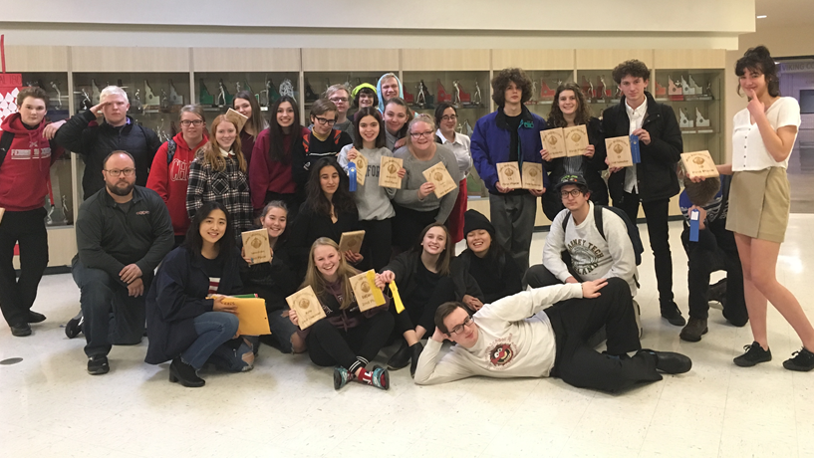
Welcome!
Ferris Speech and Debate 2021-2022

Slide 2
What have we signed up for?!? Speech Debate
Platform Issues Speeches
Informational
Persuasive
Interpretive Speeches
Humorous
Dramatic
Program of Oral Interpretation
Extemporaneous, Impromptu, Editorial Commentary
Policy/Cross-Examination Debate
Team of 2
1 topic all year (Reducing arms sales)
Public Forum Debate
Team of 2
2-month topics (Offensive cyber ops)
Lincoln-Douglas Debate
Solo debate
2-month topics (Standardized tests)
Congressional Debate

Slide 3
Speech Coursework In-Class At Home
Research
Topics and Scripts
Support material
Outlines/Cutting Scripts/Drafts
Blocking/Storyboards/Characters
Delivery/Movement
Speaking on Demand
So many practices and critiques!!
WE NEED YOUR SUPPORT!!
Ask to hear the speech multiple times each week (or read what they have).
Give gentle but honest feedback:
Does it hold your attention?
Is it easy to follow?
What works or needs attention?
Ask about due dates and schedules.

Slide 4
Debate Coursework In-Class At Home
Small-Group topic analysis
Definitions
Case strategy and Theories
Research leads
Individual/Team Research
Drafting/Writing Cases (multiple)
Practice Rounds
Drills – Speaking, Flowing, Rebuttals
Talk through the topics
Play Devil’s Advocate
Challenge arguments
Ask to hear BOTH sides of an issue
Share your opinions, insights, knowledge
Encourage lines of research
Have them read and explain cases

Slide 5
BEFORE EVERY TOURNAMENT:
PLEASE MAKE SURE THAT AT LEAST ONE SPEECH IS MEMORIZED AND THAT CASES ARE PREPARED!
A UNITED FRONT JUST MIGHT WORK!☺

Slide 6
The 2021-2022 Schedule

Slide 7
Fall Retreat – camp reed – 10/15-17
All SRHD Guidelines and SPS Policies will be followed.
Modeled after the Band retreat.
Information regarding policy and procedures will be emailed to parents and posted on the website.
Late arrival and early departure can be arranged if needed.
As always, at parent discretion.

Slide 8
What does a GSL tournament entail? Friday Saturday
Depart school gym at approx. 6:30AM
Arrive, check-in, warm-up/prep
Breakfast (small items)
7:30 Round 1 of Speech
9:00 Round 4 of Debate
11:00 Round 2 of Speech
12:00 Round 5 of Debate
2:00 Round 3 of Speech
3:00 Debate Eliminations begin
5:00 Speech Finals and Dinner
7:30 Awards
Finals Rounds as needed
Approx. 9:00 depart for Ferris / Approx. 9:30 arrive at Ferris
Depart school gym at approx. 2:00PM
Arrive, register, warm-up/prep
3:00 Round1of Debate
5:00 Round 2 of Debate
Dinner
7:00 Round 3 of Debate
Approx. 9:00 depart for Ferris / Approx. 9:30 arrive at Ferris

Slide 9
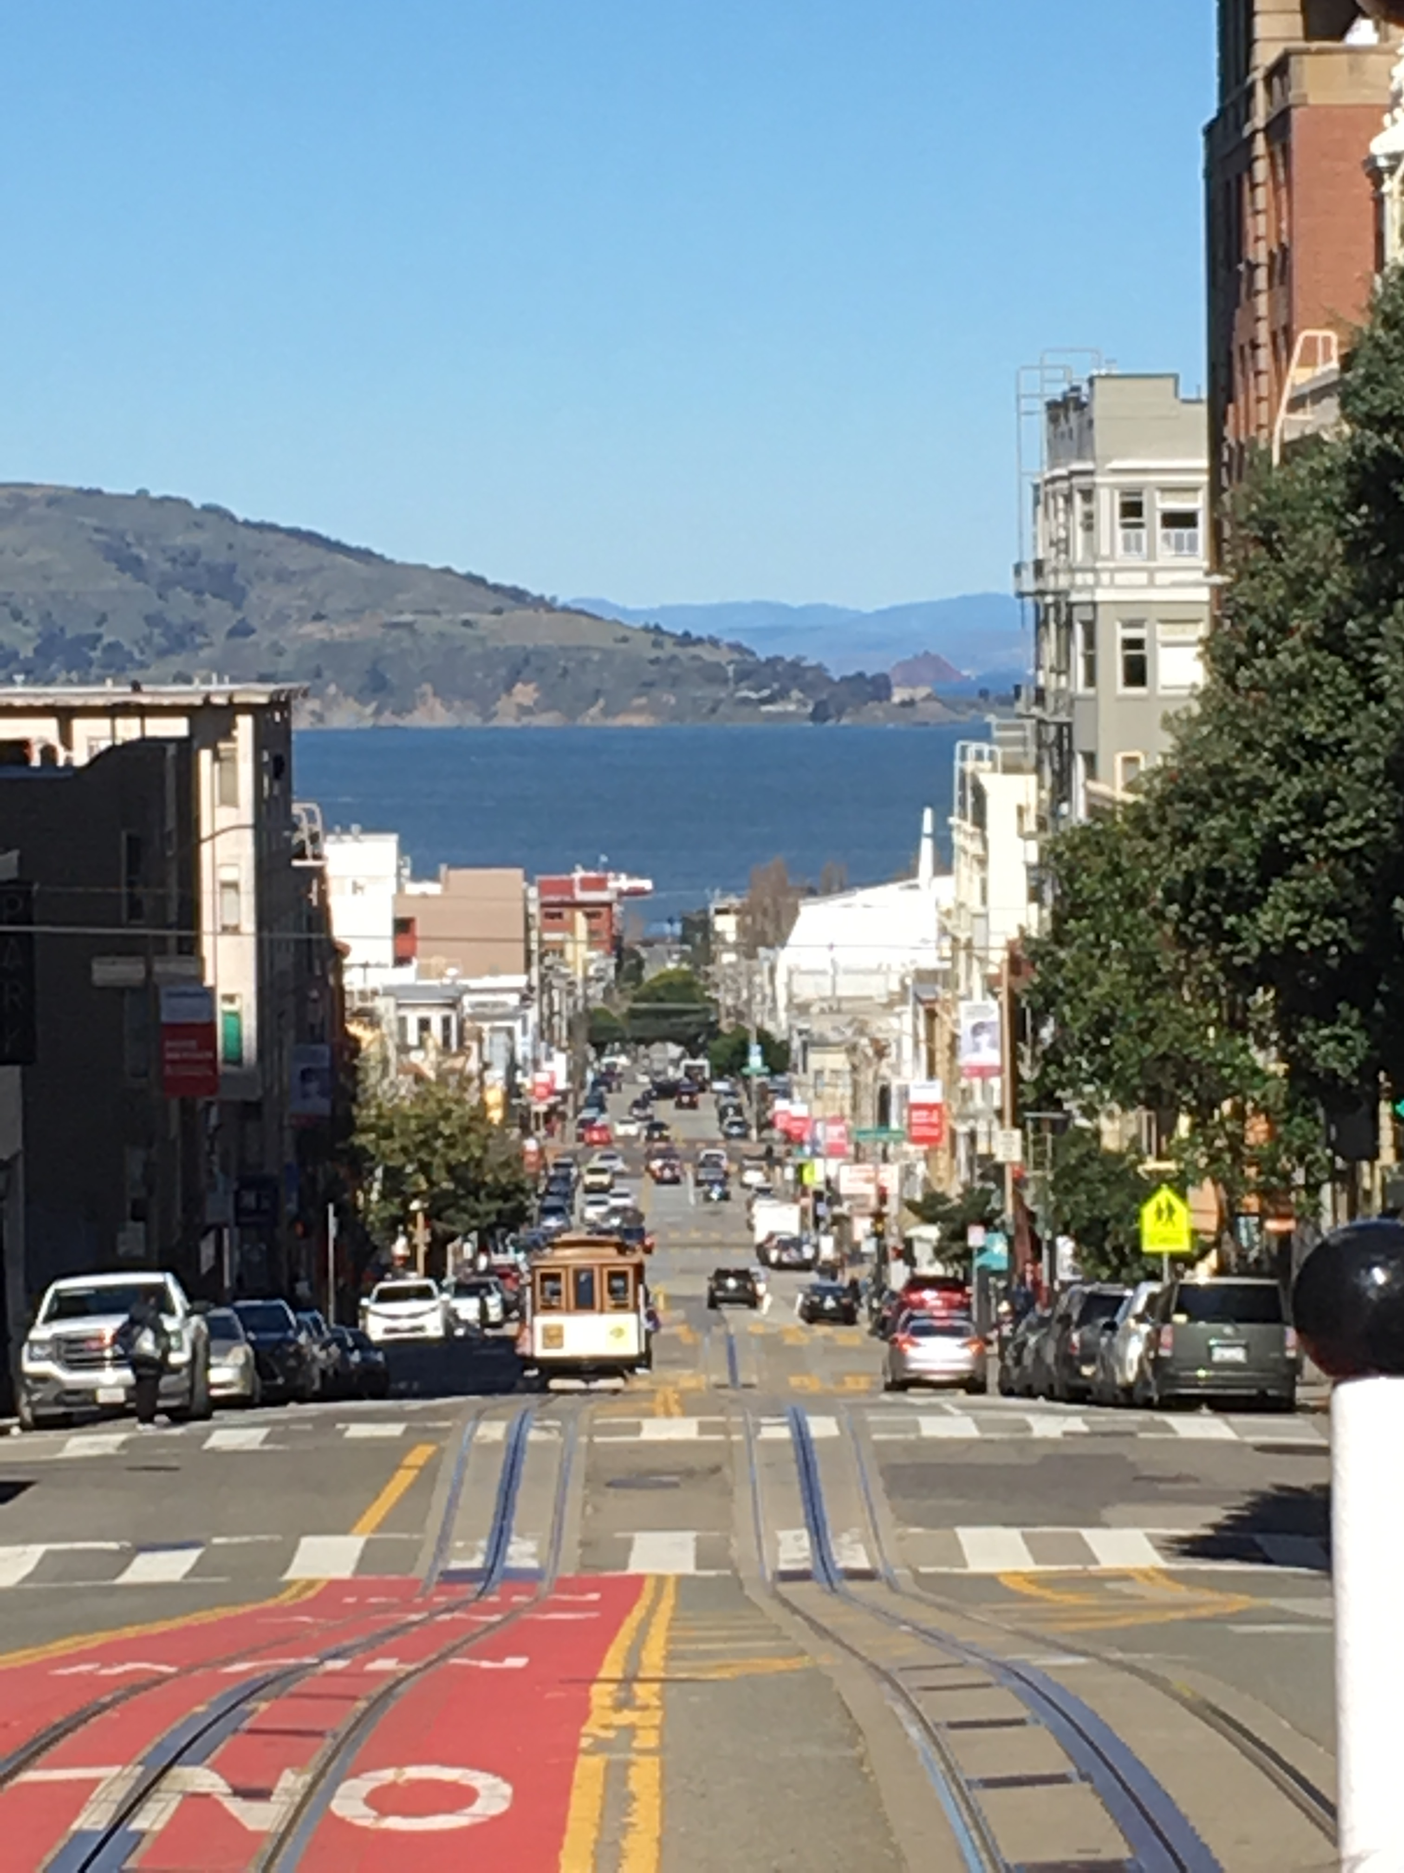
Travel Tournaments
Approximate Costs:
Chiawana, Pasco - $50.00- $100.00
California Berkeley - $800.00
State Qualifiers Tri-Cities - FREE
T.O.C. Kentucky and NCFL Nationals require prequalification and costs will be determined once qualified

Slide 10
Roles for parents (or Substitutes) Judging Food
We need approximately 10 judges for each GSL tournament
3 assistant coaches
Local volunteers and former students
PARENT JUDGES:
30 families
1 Fall tournament/1 Spring tournament
Sign-up form to follow
We make sure that all Ferris Debaters have a healthy Friday dinner and Saturday breakfast/lunch/dinner.
For each meal we need:
Serving items
Entrees
Side dishes
Snacks
Drinks/Water
Vegetarian options

Slide 11
Judge Trainings
All trainings will be in M019 at 6:00 unless otherwise requested.
November 3
November 10
December 1
January 19
February 1
Trainings can be scheduled online if needed as well.

Slide 12
Sign-up forms and links to Sign-Up Genius will be out to you soon and linked to the Debate Website. If we all sign up in advance, it will take the stress out of the year!

Slide 13
Together we can make it possible for these amazing kids!

